Slide 1

Git Basics

Slide 2
Aims of This Presentation
Provide an understanding of Git
Explain Basic Git implementation for PayPal Non-Live Code Base

Slide 3
Git training agenda
Lesson 1: Software Configuration Management
Lesson 2: Git History
Lesson 3: Features and Designs
Lesson 4: Basic Git Concepts
Lesson 5: Basic Git Commands
Lesson 6: Basic Git Process

Slide 4
Software Configuration Management (SCM)
The discipline of managing how software in modified and built through techniques via source code control.
SCM involves identifying the configuration of the software at given points in time, systematically controlling changes to the configuration, and maintaining the integrity and traceability of the configuration throughout the software lifecycle.

Slide 5
Git History
Developed by Linus Torvalds (creator of Linux) wanted a distributed system that he could use like BitKeeper, but none of the available free systems met his needs, particularly his performance needs.
The development of Git began on April 3, 2005 and is ongoing. Strongly influenced by BitKeeper, Torvalds deliberately attempted to avoid conventional approaches, leading to a unique design. He developed the system until it was usable by technical users, then turned over maintenance on July 26, 2005 to Junio Hamano, a major contributor to the project. Hamano was responsible for the 1.0 release on December 21, 2005, and remains the project's maintainer.

Slide 6
Features and Design
Strong support for non-linear development
  Git has lightweight branching and merging.
  Includes powerful tools for visualizing and navigating non-linear development history.
Distributed development
  Each developer has a local copy of the entire development history
Cryptographic authentication of history
  Git history is stored in such a way that the name that a particular revision (commit) depends upon the complete development history leading to that commit
Pluggable merge strategies
  As part of its toolkit design, Git has a wee-defined model of an incomplete merge, and it has multiple algorithims for completing it.
Efficient handling of large projects
  Git is very fast and scales well even when working with large projects and long history.

Slide 7
Basic Git Concepts
Blobs:
Each version of the file is represented as a blob. Blob contains
data but not meta data.
Trees:
A tree object represent one level of directory information. It
records blob identifiers, path names and a bit of meta data for
all the files in one directory and other subtree information.
Commits:
A commit object holds meta data for each change introduced
into the repository including author, commiter, commit date
and log message.
Tag:
Tag object assigns an arbitrary yet presumably human
readable name to a specific object usually a commit.

Slide 8
Basic Git Concepts …
SHA1:
Each object in the object store has a unique name produced by
applying SHA1 to the contents of the object, SHA1 is unique.
The .git directory:
Each git repository has a hidden directory “.git” which holds
vital information and is the heart for version control for that git
directory. Do not touch the “.git”.
Tags:
Git contains 2 types of tags called light weight and annotated.
Light weight tags are simply references to commit objects and
are considered private to a repository. Non permanent.
Annotated tags are more substantial and creates an object.

Slide 9
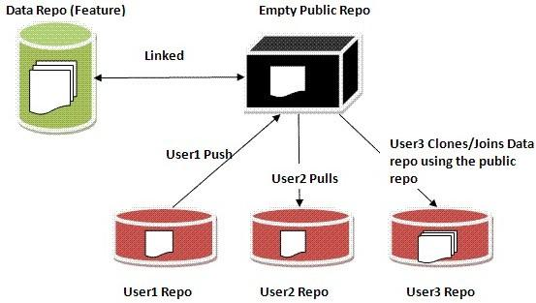
Basic Git Concepts …
Repository:
A GIT repository is one which contains the files and meta-data,
with complete history and full revision tracking capabilities, not
dependent on network access or a central server.
Clone:
A clone is a full-fledged copy of a repository that allows you to
modify, add, delete files, inspect it’s logs and history, and so
on. It is a complete repository with full history.

Slide 10
Basic Git Concepts …
Repository Model for PayPal:
There will be three kinds of repositories.
Data Repository (.repo)
This repository will contain actual data. It will have limited access and will be backed up regularly.
Similar to VOB in CC.
Bare Repository (.bare)
This repository does not have code and is only used for cloning, push and pull.
Clone Repository
This repository is clone from the bare repository and contains all files available in data repository.
Similar to snapshot view in CC.

Slide 11
Basic Git Concepts …
The Index:
Git’s index doesn’t contain any file content; it simply tracks
what you want to commit. When you run a git commit, git
checks the index rather than working directory to discover
what to commit.
File Classifications in Git:
Tracked:
A tracked file is any file already in a repository or any file that
is staged in the index. To add a new file to the index run “git
add <file_name>”.
Ignored:
An ignored file must be explicitly declared “invisible” or
“ignored” in the “.gitignore” file in the repository.
Untracked:
An untracked file not found in previous two catagories. Use “git
add” to track files in git.

Slide 12
Basic Git Commands
Create a new file / modify existing file:
Adding a new file in git requires “git add” and “git commit”.
To modify existing file you need to commit the changes to track.
Identifying Commits:
The unique SHA1 commit id is a globally explicit reference and is
an implied reference
Delete or Rename a file:
To delete a file use “git rm <file_name>”.
To rename a file use “git mv <old_name> <new_name>”
If you had done OS level delete or rename you need to commit the
changes to be tracked in git.
Check the status of files:
The status of the file in git can be easily checked using “git status”
command.

Slide 13
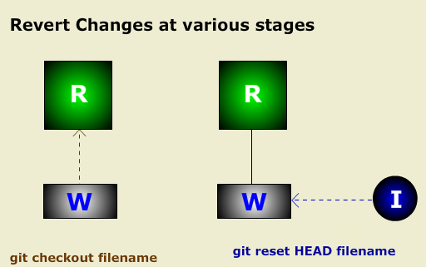
Basic Git Commands …
Revert changes before Indexing:
If you don’t need the changes that you have made to the files, you may discard changes using “git checkout <file_name>”.
Reverting changes after Indexing:
If you don’t need a file to be committed that has been added to the index area, you may unstage the file using “git reset HEAD filename”.

Slide 14
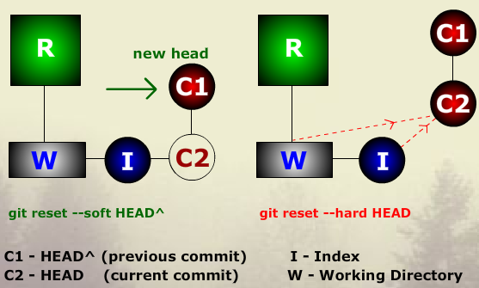
Basic Git Commands …
Move your pointer to the previous Head:
If you have forgot something to add in the previous commit, you can reset the HEAD back to back the previous commit (HEAD^) and add the changes using “git reset –soft HEAD^”.
Discard changes in Index and working directory:
If you want to discard all staged and unstaged changes you may reset to discard all changes using “git reset –hard HEAD”

Slide 15
Basic Git Commands …
Find who committed what:
git blame <file_name>
See the GIT log:
git log
git whatchanged (gives you better output)
To get a file from a specific version:
You may want to see a file that was committed 4 version
before the current HEAD, for that you can use
“git show HEAD~4:<filename>”
See the differences:
git diff (Changes in the working tree not yet staged)
git diff –cached (Changes b/w index and last commit)

Slide 16
Basic Git Commands …
git diff HEAD (Changes in working tree since last commit)
git diff spec-123…live-630
(Changes between tip of 630 and tip of spec-123 branch)
git diff spec-123…live-630
(Changes in 630 since when spec-123 branch was started off it)
Restoring a file/directory from history:
Lets say your file was removed in 2 commits before and you need
to get it back, git allows this using
“git checkout HEAD~2 – <removed_filename>”

Slide 17
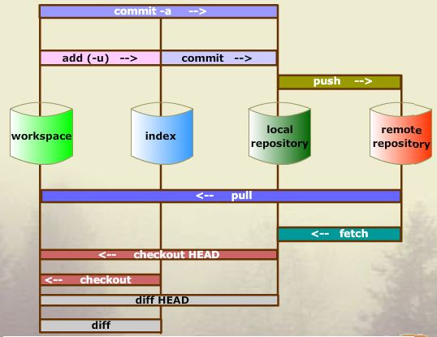
Basic Git Process
The Flow of Data:
Push – Deliver code from local clone repository and merge to remote bare repository.
Pull – Rebase code from remote bare repository and merge to local clone repository.
Fetch – Get data from remote bare repository and put in local repository but does not merge.

Slide 18
Basic Git Process …
Pull your code:
UNIX users may either fetch and merge or do a direct Pull.
Windows users have to do a fetch and merge graphically.
“Git fetch” will fetch all the remote branches to the local
repository and then you can merge any of the remote
branches to your local branches using the command “git merge
origin/branchname”. You need to be on the target branch
before merging the fetched remote branch.
Remote branches start with origin and can be checked with
“git branch –r”

Slide 19
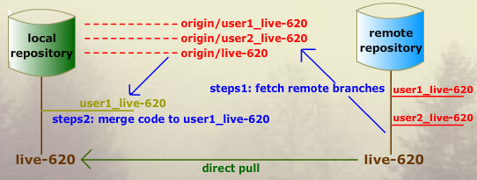
Basic Git Process …
Else UNIX users may directly do a pull after checking out their
target branch using ‘git pull origin live-620”.
You may later merge this code with user1_live-620 branch.
Note: You need to pull before push

Slide 20
Basic Git Process …
Push your code:
The recommended way to pull your code from your
development branch is to merge with local live-620 branch and
then push from local live-620 to remote live-620 branch.
git checkout live-620 (Switch to main branch)
git merge user1_live-620 (Merge branches to main)
git push origin live-620 (Push code to remote main)
Suppose if you just want your branch to be visible to others
and you do not want to merge code with remote live-620 you
may push your branch alone.

Slide 21
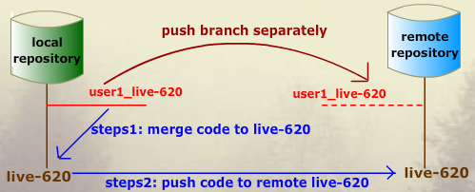
Basic Git Process …
Git push origin user1_live-620
Others can fetch your branch or track it locally.
Origin points to your remote repository

Slide 22
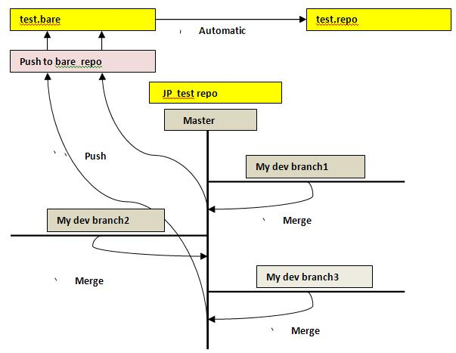
Basic Git Process …
Branches and merges
Branches are a smart way of managing code isolation in Git. You may work on the local master branch, but some may want to further isolate their code. Git branches are lightweight and are inexpensive to create and maintain.
The process:
Create a branch based off your
master branch
work on changes, commit then test
Merge good changes back to
master branch
Remove or keep branch for future
reference
Pull/Push to parent repository

Slide 23
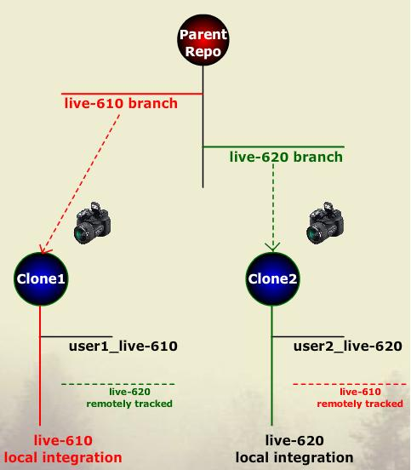
Basic Git process …
Working on Branches and Merges
Branches provide a way of isolating work or creating separate
new releases from a release on a main/master branch
To list the local branches
git branch
To list the remote branches
git branch –r
(remote branches start with origin)
To track remote branch locally
git branch –track <newbranch>
To switch branches
git checkout <branch_name>
To delete branches
git branch –d <branch_name>
Merge branches
You need to be on the target branche (checkout)
And then do “git merge <source_branch>”

Slide 24
Requisites for working in Git
For UNIX Development
Access to hyper with Git v1.6.5 and above
pursers as primary group in your ID
Tools like Cygwin, Exceed for Git GUI (optional)
For Windows Development
Mysysgit 1.6.5 installed on Windows machine
ppusers as primary group in your ID
SJC users can use their local desktops
Other (IDC, SGP, AUS, PHX) have to use TPA machines

Slide 25
Git
Questions ?

